Slide 1

IOT-GREENHOUSE CLIMATE CONTROL
Students: Nedealcova Irina, Bujilov Dmitrii, Cravcenco Dmitrii, Ciornii Alexandr
Group: FAF-223

Slide 2

Table of Contents
Problem Definition
Our Solution
Example of IoT Smart Greenhouse
The Future of IoT in Agriculture
Stakeholders Map
Our Solution Includes
Main Components
Priority System Requirements
How It Works
Conclusion

Slide 3

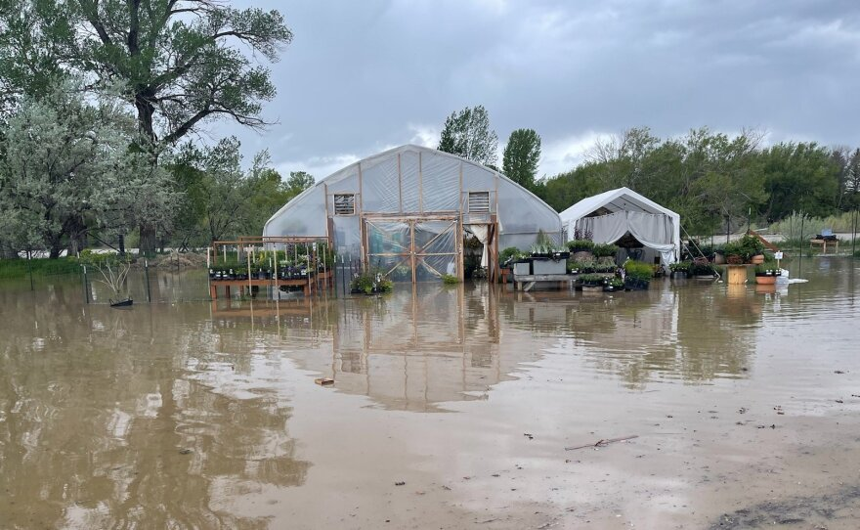
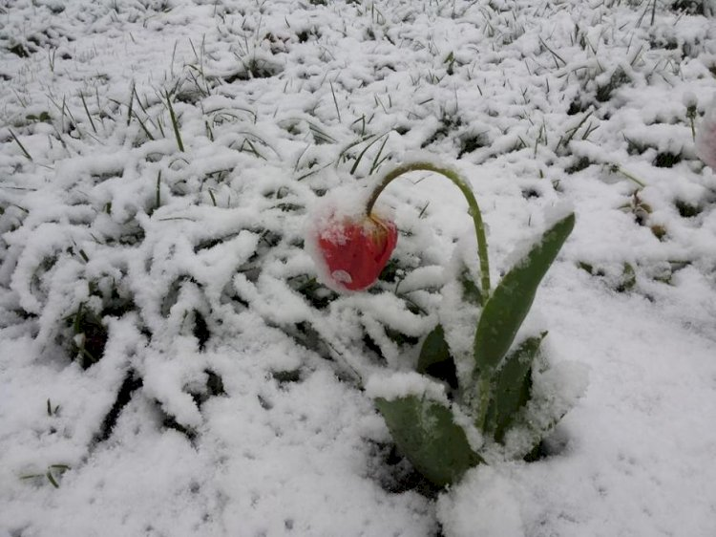
Problem Definition
Our agriculture is challenged by both the impact of weather events like floods, frosts, and hail, and the intricate management required for temperature, humidity, light, and CO₂ control.

Slide 4

Our Solution
An IoT-enabled, autonomous system designed to optimize greenhouse climate conditions.
Key Goals:
Boost plant growth with stable conditions
Auto-adjust climate using live data
Enable remote monitoring and alerts

Slide 5
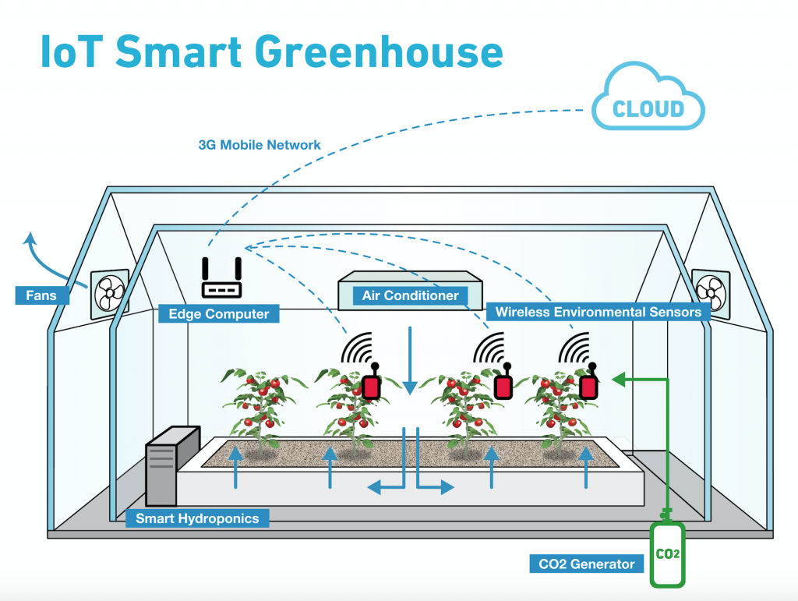
Existing Smart Greenhouse solution
Sensors track climate conditions and send data to cloud. Automated systems adjust temperature, humidity, and CO2. Smart hydroponics improves growth with less water, making farming easier and more productive.

Slide 6
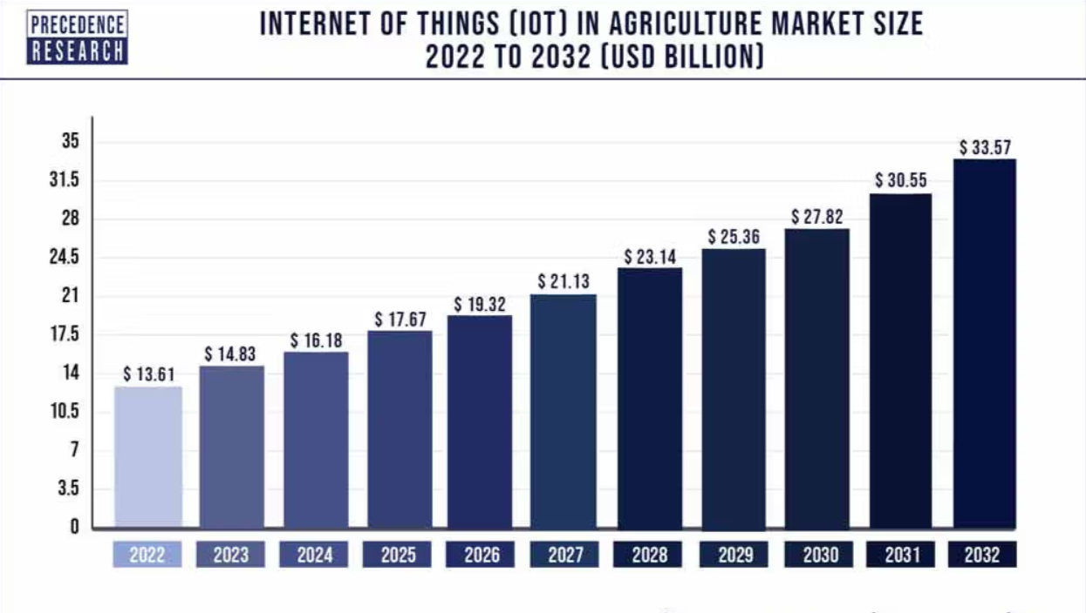
The Future of IoT in Agriculture

Slide 7
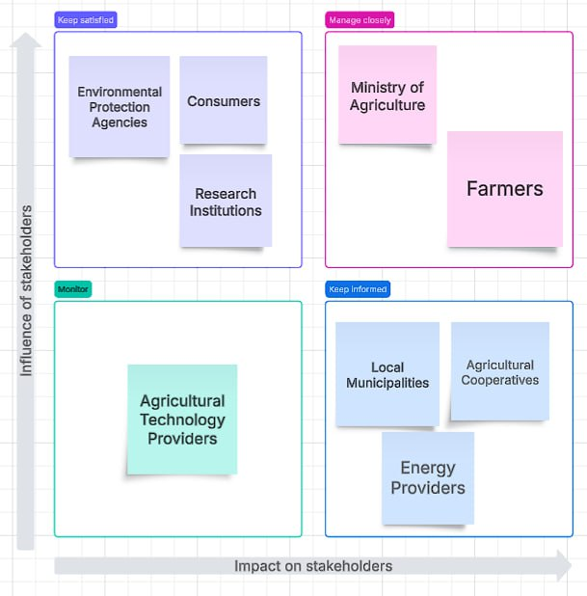

Stakeholders map

Slide 8
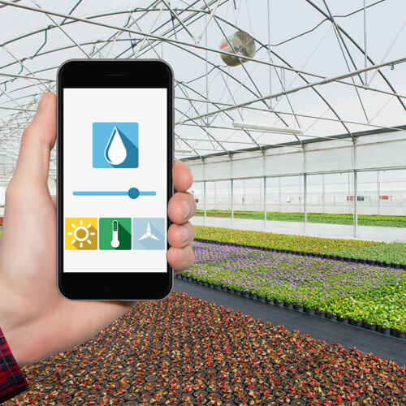
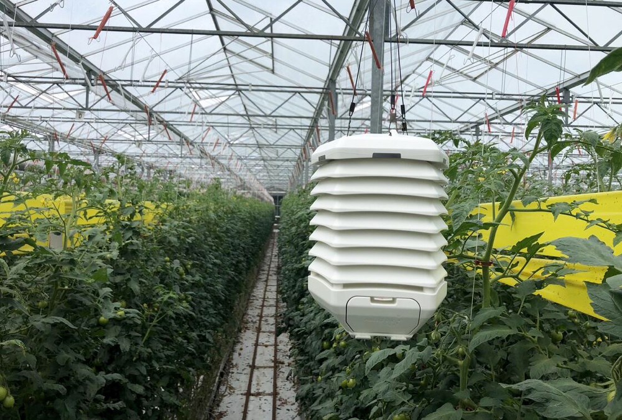
Our solution includes
Sensors
Automated Controls
Data Processing
Remote Access & Alerts

Slide 9
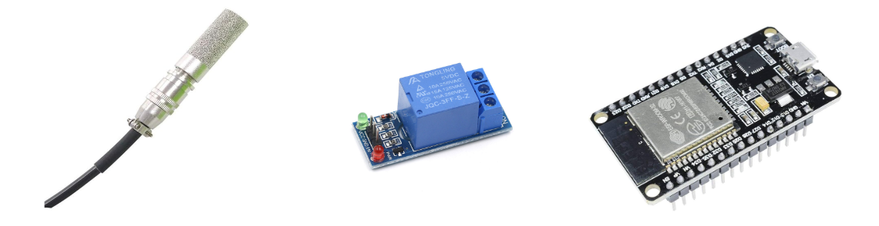
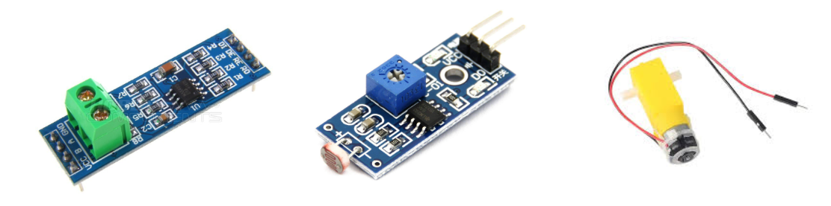
SHT30 Sensor Relay Module1 Channel ESP32
RS - 485 Module LM393 Light Sensor TT Motor

Slide 10
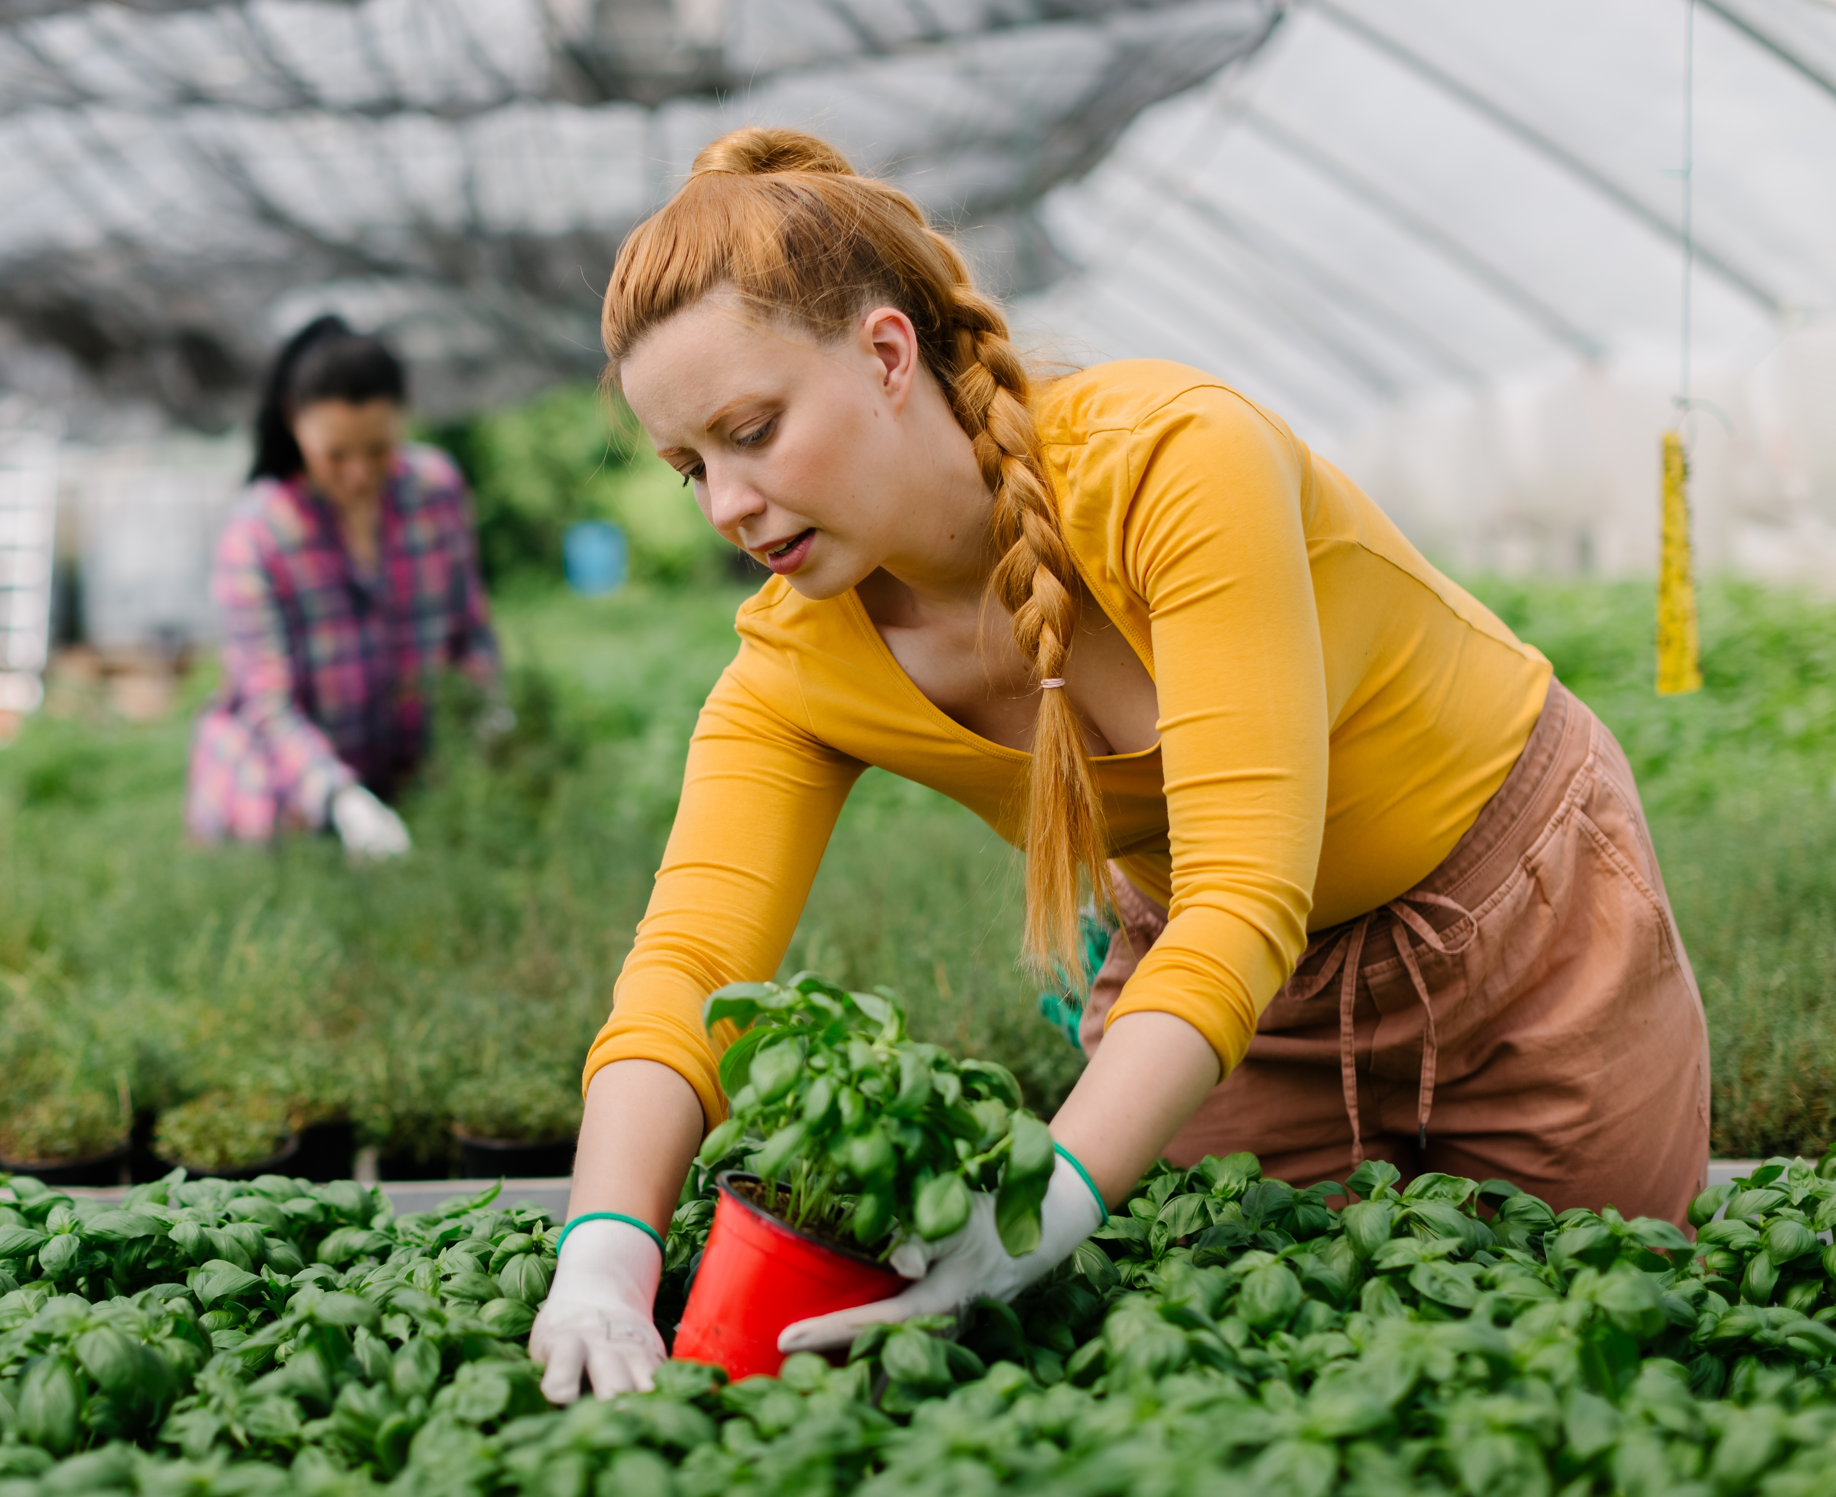
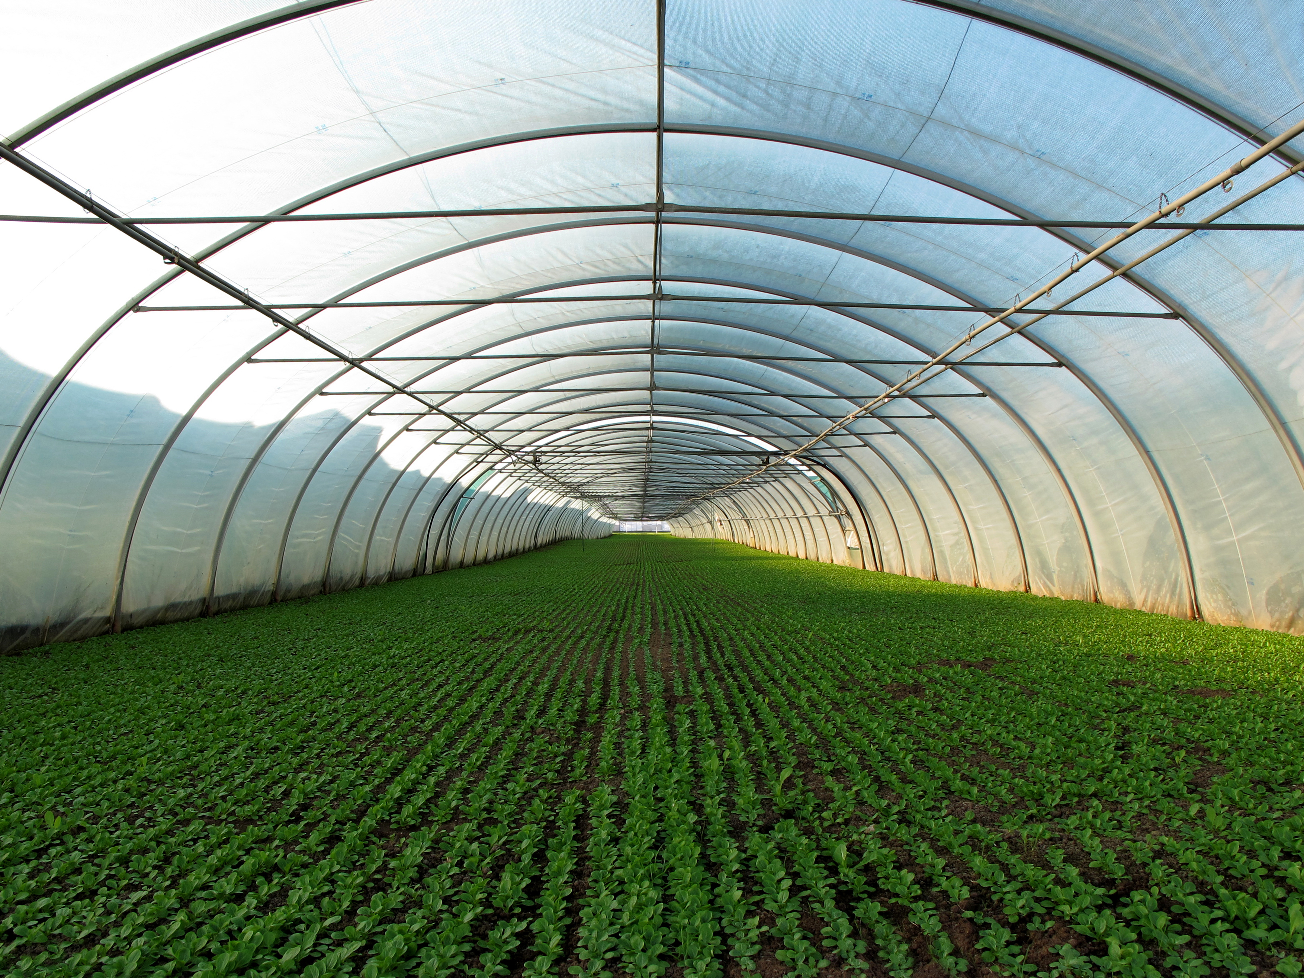
Priority System Requirements:
Automated climate control
Real-time monitoring
System failure notifications
Balance accuracy with efficiency
Energy optimization
Integration with existing systems
Minimal error rates
Configurable climate parameters

Slide 11
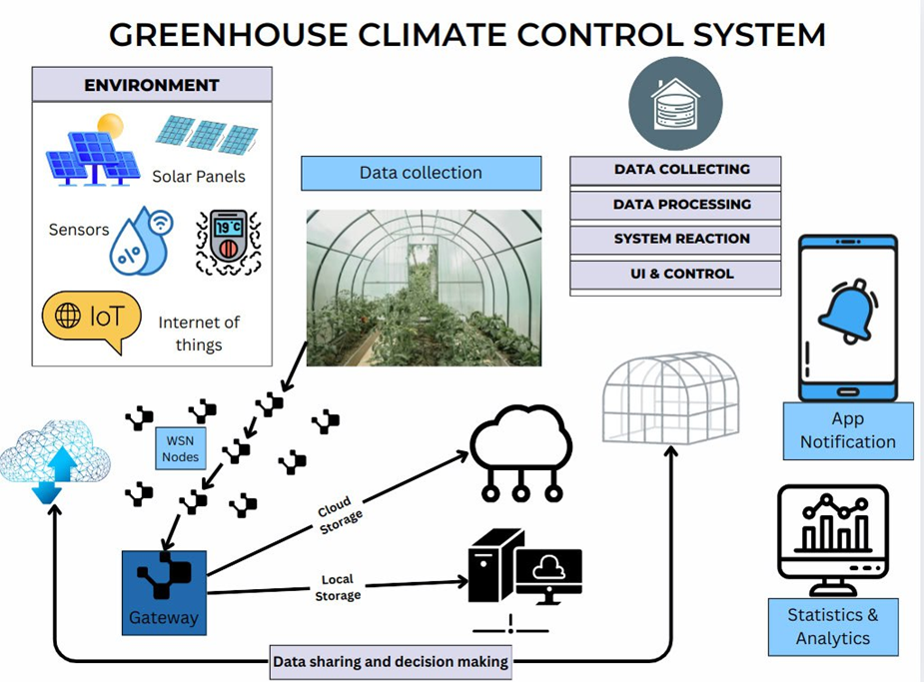

Slide 12
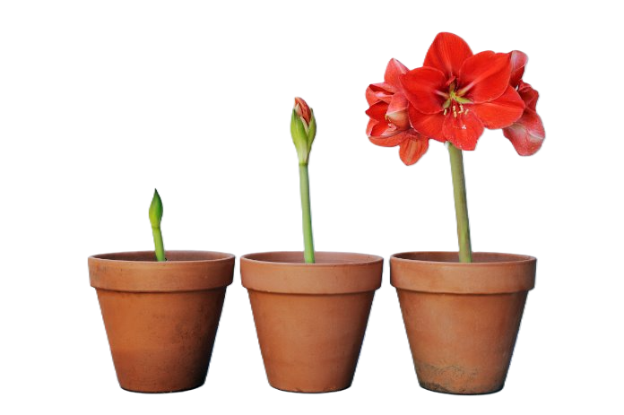
Conclusion
Our smart greenhouse system helps Moldovan farmers grow more food with less work. It controls the climate on its own and uses fewer resources. This makes farming easier even when weather is bad.
"GROWING SMARTER, HARVESTING BETTER."

Slide 13

THANK YOU FOR YOUR ATTENTION!
Q/A TIME

